Slide 1
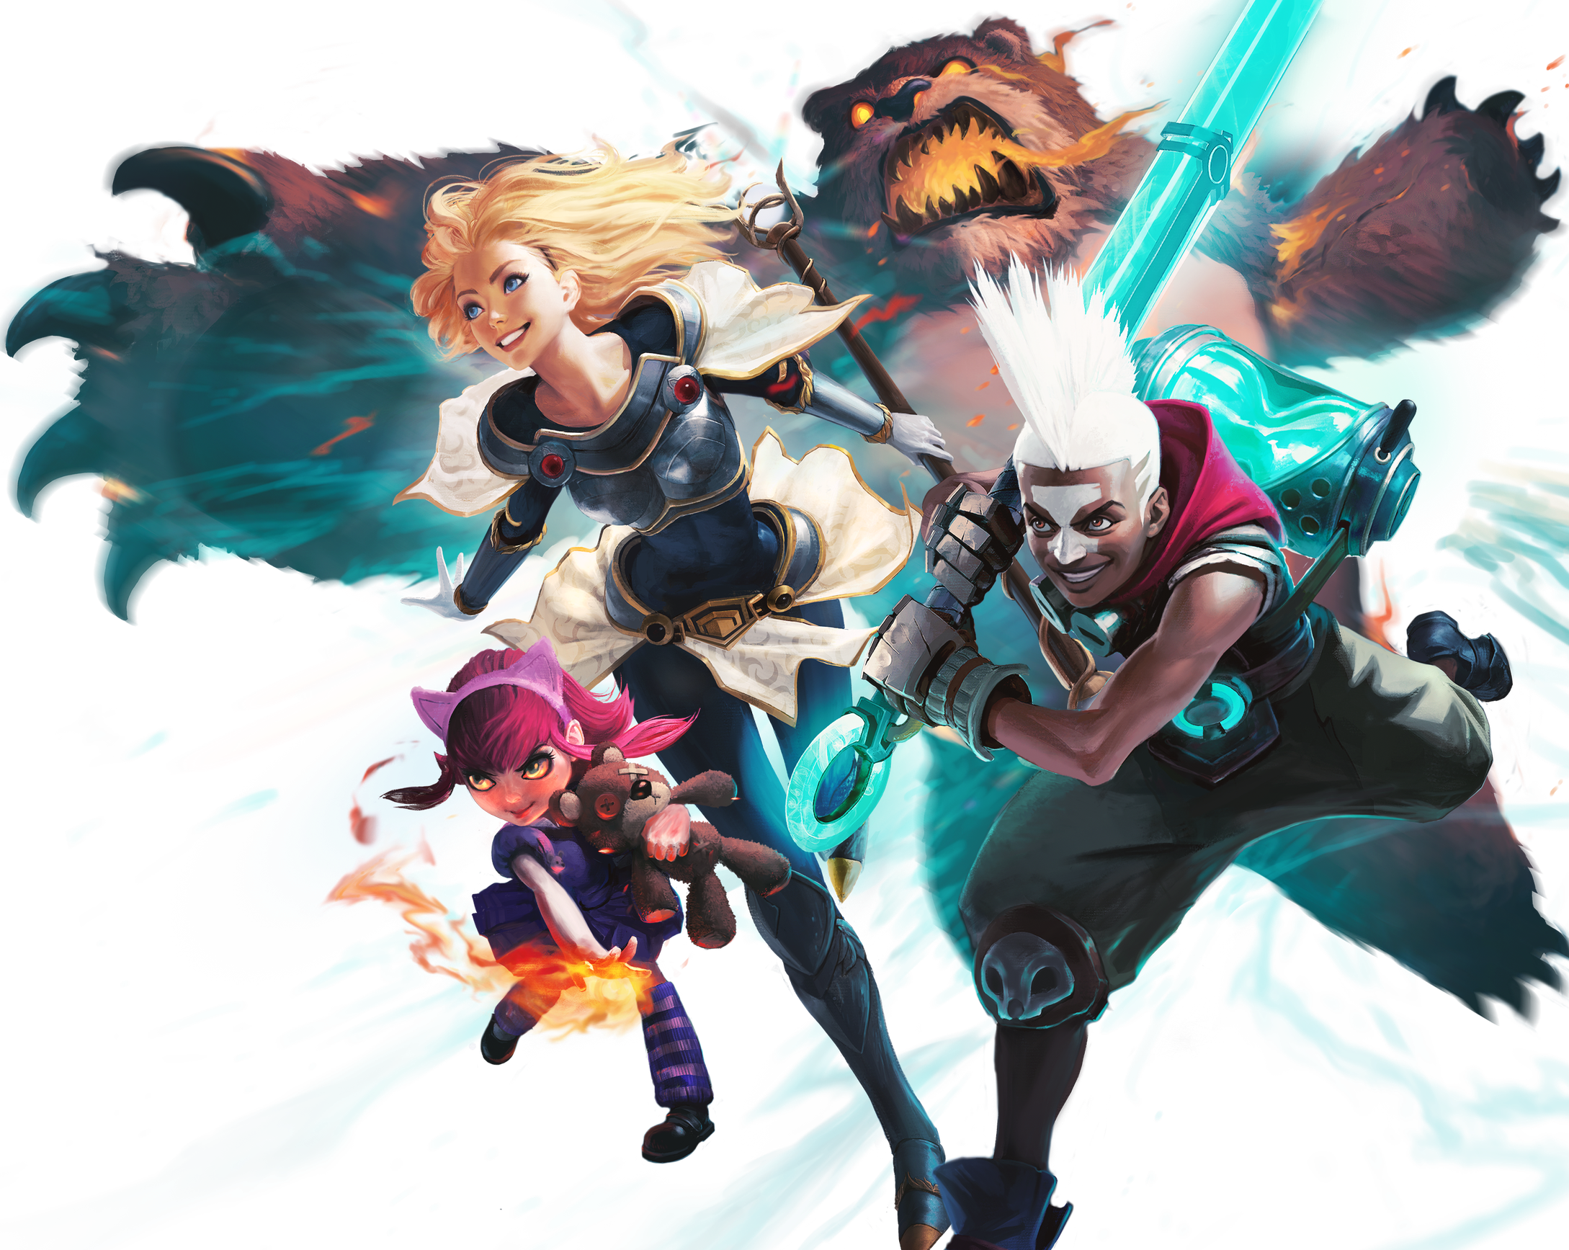
LEAGUE OF LEGUENDS
More Than Just a Game

Slide 2
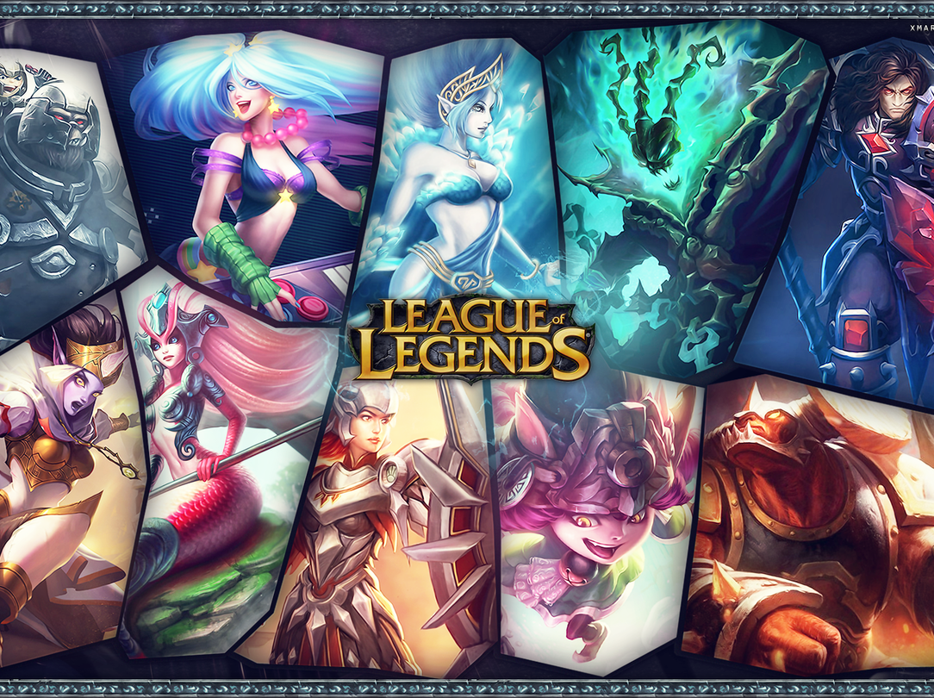
What is League of Legends?
League of Legends, or LoL, is a free online game created by Riot Games. It is a multiplayer online battle arena, or MOBA. In the game, two teams of five players fight to destroy the enemy’s base, called the Nexus.

Slide 3
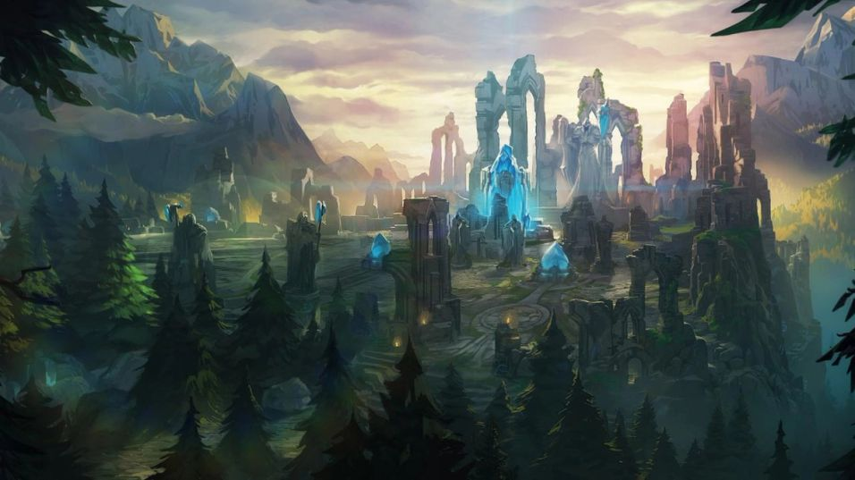
How is the Game Played?
The main map is called Summoner’s Rift. Each team has three lanes: top, middle, and bottom. The goal is to push through the lanes, kill enemies, and take towers.

Slide 4
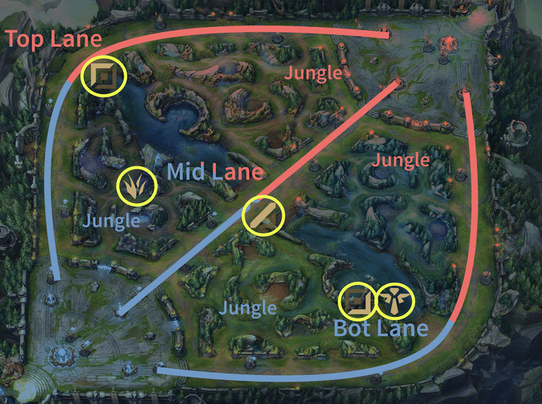
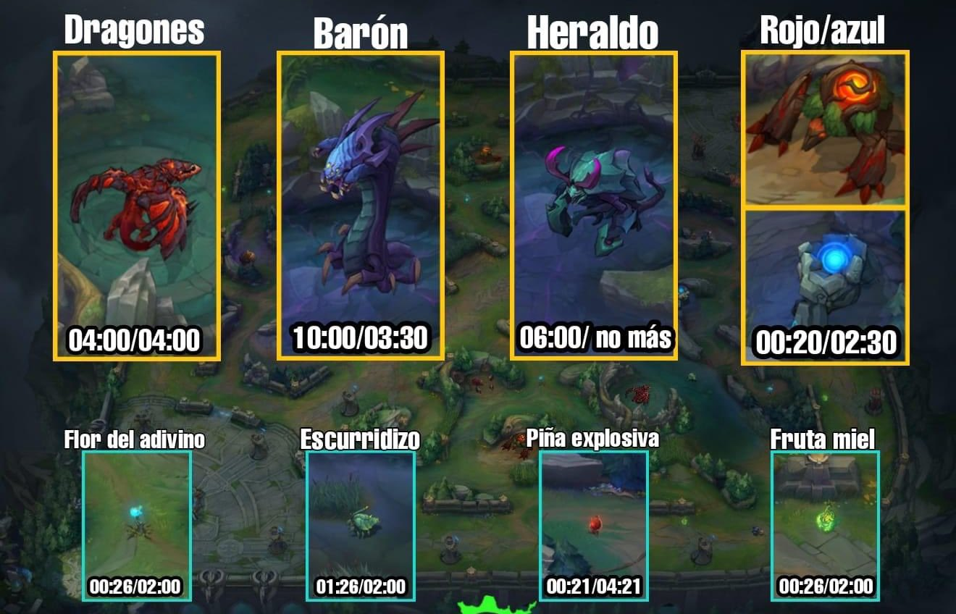
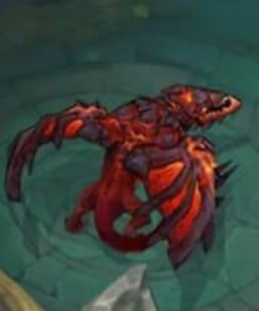
The Map and Lanes
Top laner
Mid laner
Jungler
ADC (Attack Damage Carry)
Support

Slide 6
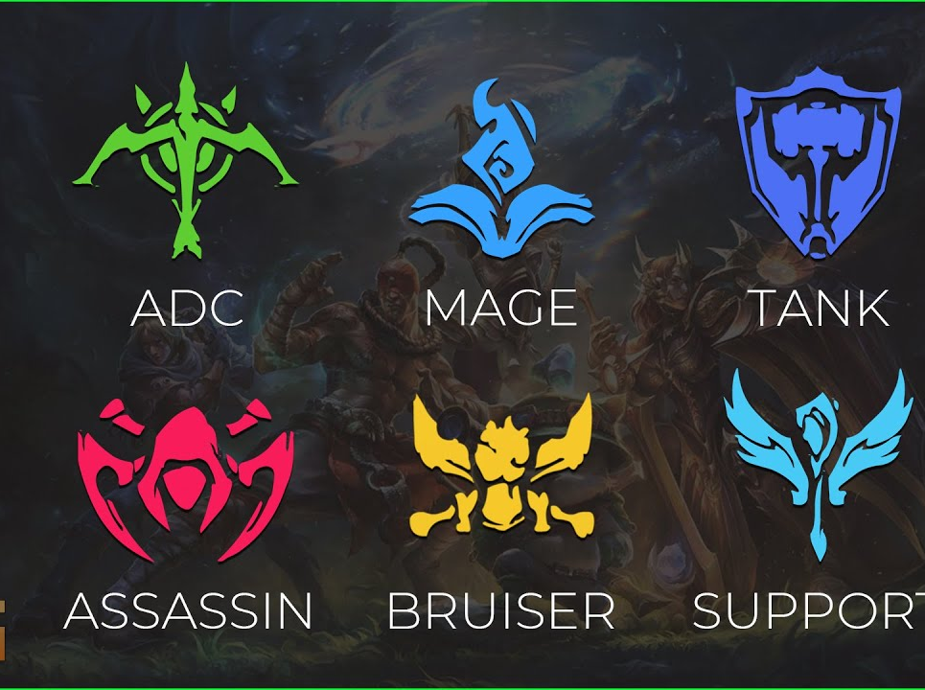
Champion Sub-Roles
Tank: Absorbs a lot of damage and protects teammates.
Fighter (Bruiser): Balanced between damage and defense.
Mage: Uses magic damage from long range.
Assassin: Deals high damage and can kill quickly.
Marksman: Ranged physical damage dealer.
Enchanter: Heals and buffs allies.

Slide 7
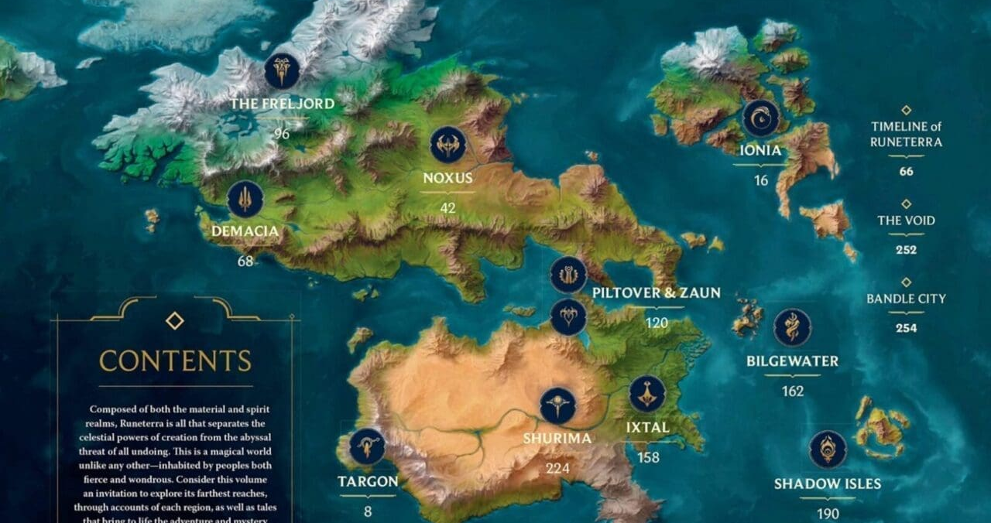
The Lore – Runeterra
Demacia
NoxusIonia
Piltover & Zaun
Freljord
Bandle City
Bilgewater
Targon
Shurima
The VoidShadow
Isles
Ixtal

Slide 8
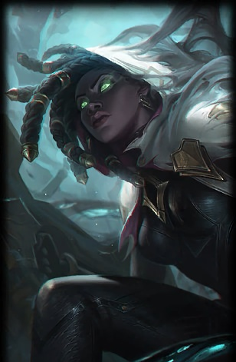
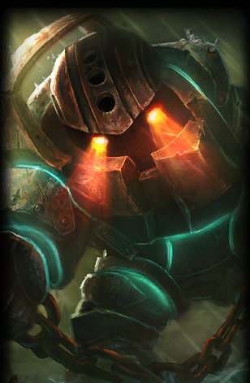
My main Champions
Nautilus: tank, control, from the ocean
Senna: ranged support, light and shadow

Slide 9
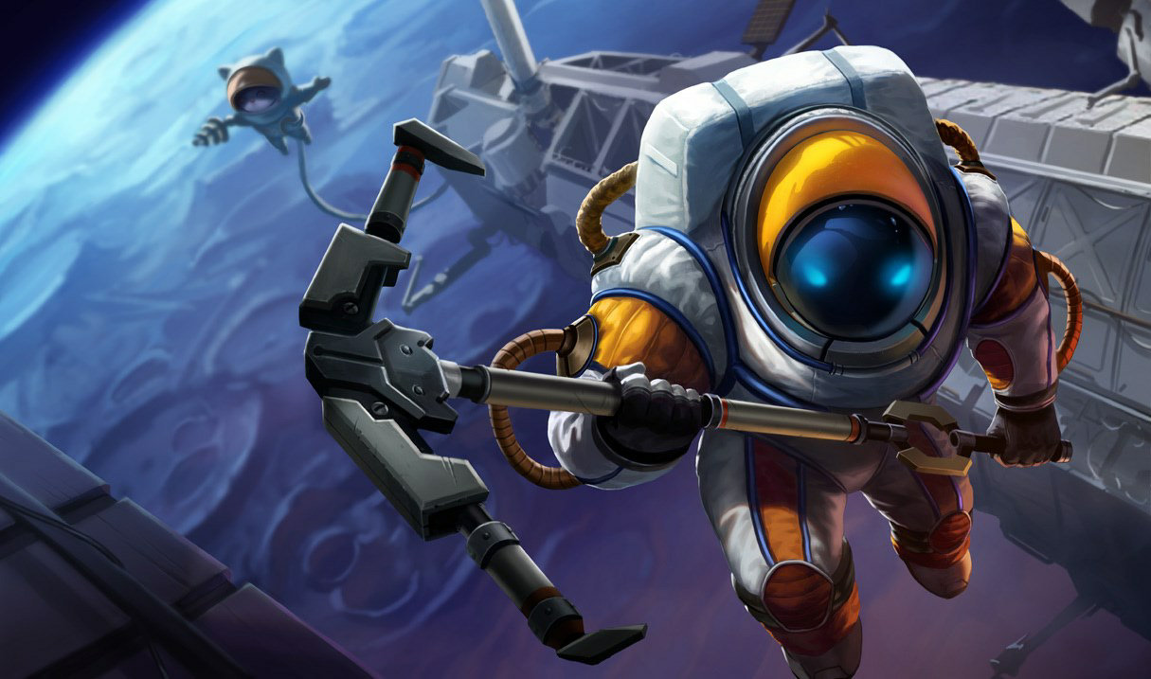
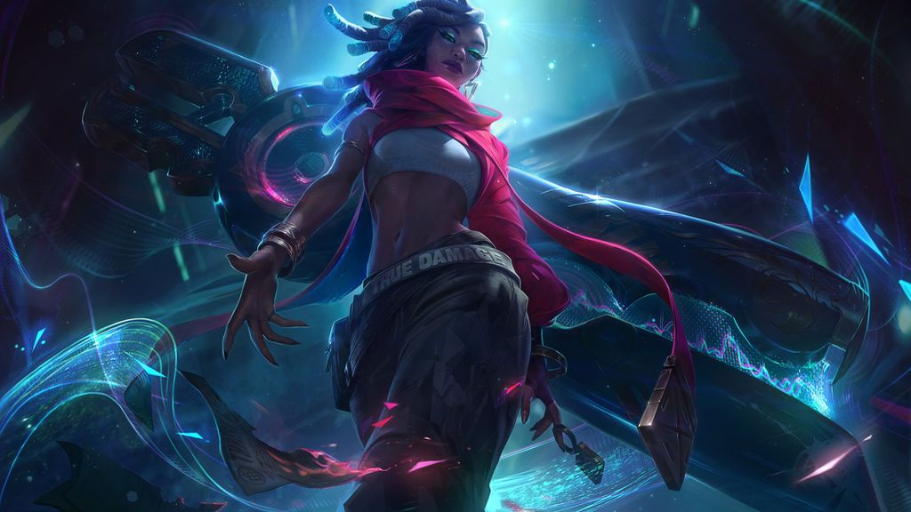
Champions Lore
Nautulus
Once a sailor from the Blue Flame Isles, Nautilus was betrayed and dragged into the depths by a dark force. Now bound in massive armor, he rises from the sea to punish those who ignore the ocean’s call.
Senna
Cursed by the Black Mist since childhood, Senna joined the Sentinels and fought bravely until she was killed by Thresh. Years later, she freed herself from his lantern and now uses the Mist as a weapon to redeem lost souls.

Slide 10
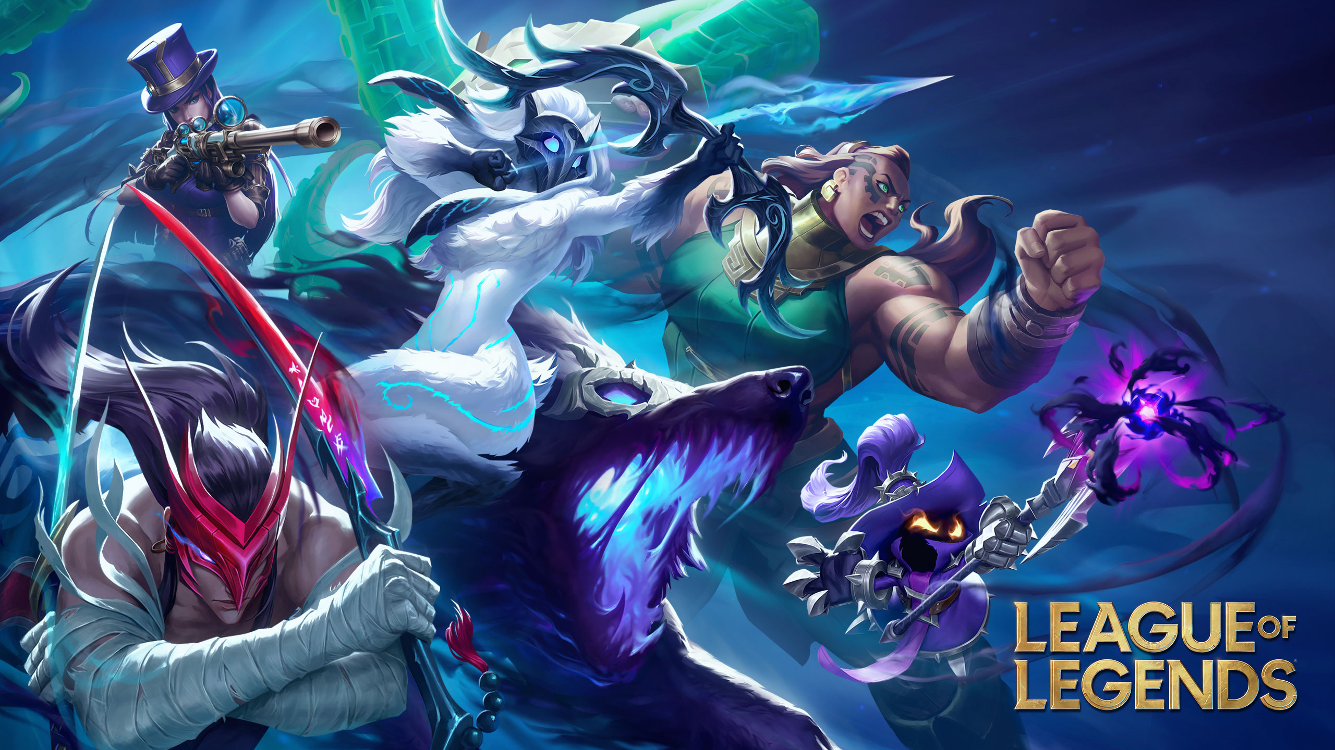
Why I Love League of Legends
Strategy
Unique mechanics
Every game is different
Lore

Slide 11
